Slide 1
ATOM SUMMER INTERNS SEMINAR SERIES
Butler Summer 2022

Slide 2
Seminar #1 by Dr. Joseph Ivanic
Date - Thu June 23, 2022, 2:00 pm – 3:00 pm ET
Meeting Link - https://teams.microsoft.com/l/meetup-join/19%3ameeting_OTdiMDIyZWMtNjAwMC00YWVhLWJmYzctMjdkNjA5YTJhMWY1%40thread.v2/0?context=%7b%22Tid%22%3a%2214b77578-9773-42d5-8507-251ca2dc2b06%22%2c%22Oid%22%3a%222e31b4fb-2c54-4995-be48-173a24bc5b84%22%7d
PRESENTER – Dr. Joseph Ivanic, Ph.D, Senior Investigator, Frederick National Laboratory for Cancer Research (FNLCR)
TOPICS – There will be two 30-minutes presentations (1 hour – 2 x 30-minutes)
Introduction to Molecules and Generative Molecular Design
Introduction to Quantum Chemistry and Use for Health Research

Slide 3
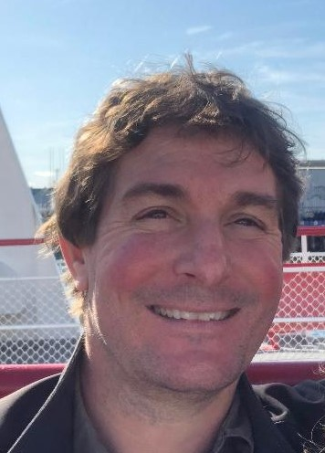
Joe Ivanic
Computational Scientist, Advanced Biomedical Computational Science
My Experience
30+ years experience in Quantum Chemistry
Developed many high-level theories/methods
Used quantum chemistry for health research
Worked at DoE, DoD, & NCI/NIH
Education
BS, Mathematics/Chemistry, University of Melbourne
PhD, Quantum Chemistry, University of Melbourne
About Me
I grew up in the remote Australian Outback
I like running/sports, cooking, crosswords, coffee
I’ve played guitar for 40+ years (rock & classical)

Slide 4
Seminar #2 by Dr. Pinyi Lu
Date - Thu June 30, 2022, 11:00 am – 12:00 pm ET
Meeting Link - https://teams.microsoft.com/l/meetup-join/19%3ameeting_YjRiZGU5NzMtOTdlZC00OTQ5LTk2YWEtNzAzNmIwMmUwZWI5%40thread.v2/0?context=%7b%22Tid%22%3a%2214b77578-9773-42d5-8507-251ca2dc2b06%22%2c%22Oid%22%3a%222e31b4fb-2c54-4995-be48-173a24bc5b84%22%7d
TITLE - Computer-Aided Drug Discovery
PRESENTER – Pinyi Lu, Ph.D., Senior Data Scientist, FNLCR, ATOM Consortium
ABSTRACT - Computer-aided drug discovery (CADD) has become an important part of the drug discovery process due to the reduced cost of computational methods and the increased availability of three-dimensional structural information. In this seminar, an introduction to CADD will be addressed. I will compare structure-based and ligand-based modeling, focusing primarily on molecular docking and quantitative structure-activity relationship models. In addition, I will present an example of application of computational methods in drug discovery and highlight some considerations in the application of CADD.

Slide 5
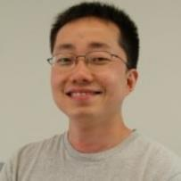
Pinyi Lu
Senior Data Scientist, Cancer Data Science Initiatives, FNLCR
My Experience
16+ years research experience on translational informatics
Collaboration with pharmaceutical companies and healthcare systems
Recent works include:
JDACS4C Pilot 1 – Predictive Modeling for Pre-Clinical Screening
AI-based drug discovery and design of anticancer drugs that target CENP-E
Education
Post-doctoral Appointment, University of Texas Health Science Center
Ph.D., Computational Biology and Chemoinformatics, Virginia Tech
M.S., Computer Science, Virginia Tech
Keywords
CADD and Machine Learning
Precision Medicine and Translational Research
Badminton and Pickleball
pinyi.lu@nih.gov
JDACS4C: Joint Design of Advanced Computing Solutions for Cancer; CADD: Computer-Aided Drug Discovery

Slide 6
Seminar #3 by Dr. Stewart He
Date - Thu July 5, 2022, 2:00 pm – 3:00 pm ET
Meeting Link - https://teams.microsoft.com/l/meetup-join/19%3ameeting_MjQ5YjgxNGEtYjEwNC00ZGQ4LThlZDYtYWM1ZTA4NmYzZjlm%40thread.v2/0?context=%7b%22Tid%22%3a%2214b77578-9773-42d5-8507-251ca2dc2b06%22%2c%22Oid%22%3a%222e31b4fb-2c54-4995-be48-173a24bc5b84%22%7d
TITLE - ChemBERTa for MM/GBSA Score Regression
PRESENTER – Dr. Stewart He, Ph.D. Senior Data Scientist, LLNL, ATOM Consortium
ABSTRACT - The best choice of feature for small organic compounds is an open question. Graph representations in combination with a convolutional neural network has proven to be very powerful, but often perform poorly in low data situations. In those cases, fingerprints or featurization methods that calculate a predetermined set of properties often do well. Most of these featurization methods are free, but one of the most successful, MOE, is not and obtaining a license and calculating MOE features expensive. ChemBERTa is a language-based model that is pretrained on a large corpus of compounds then fine tuned to a particular task. This method of representing compounds improves as the size of the pretraining corpus increases, is computationally cheap to calculate, free to download, and can perform well in situations with limited data. We compare ChemBERTA with MOE features on the task of predicting MM/GBSA, a calculated value that is correlated with a ligand’s binding affinity with a target, values on varying targets and data sizes.

Slide 7
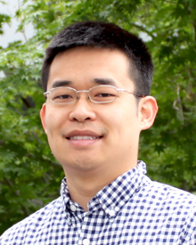
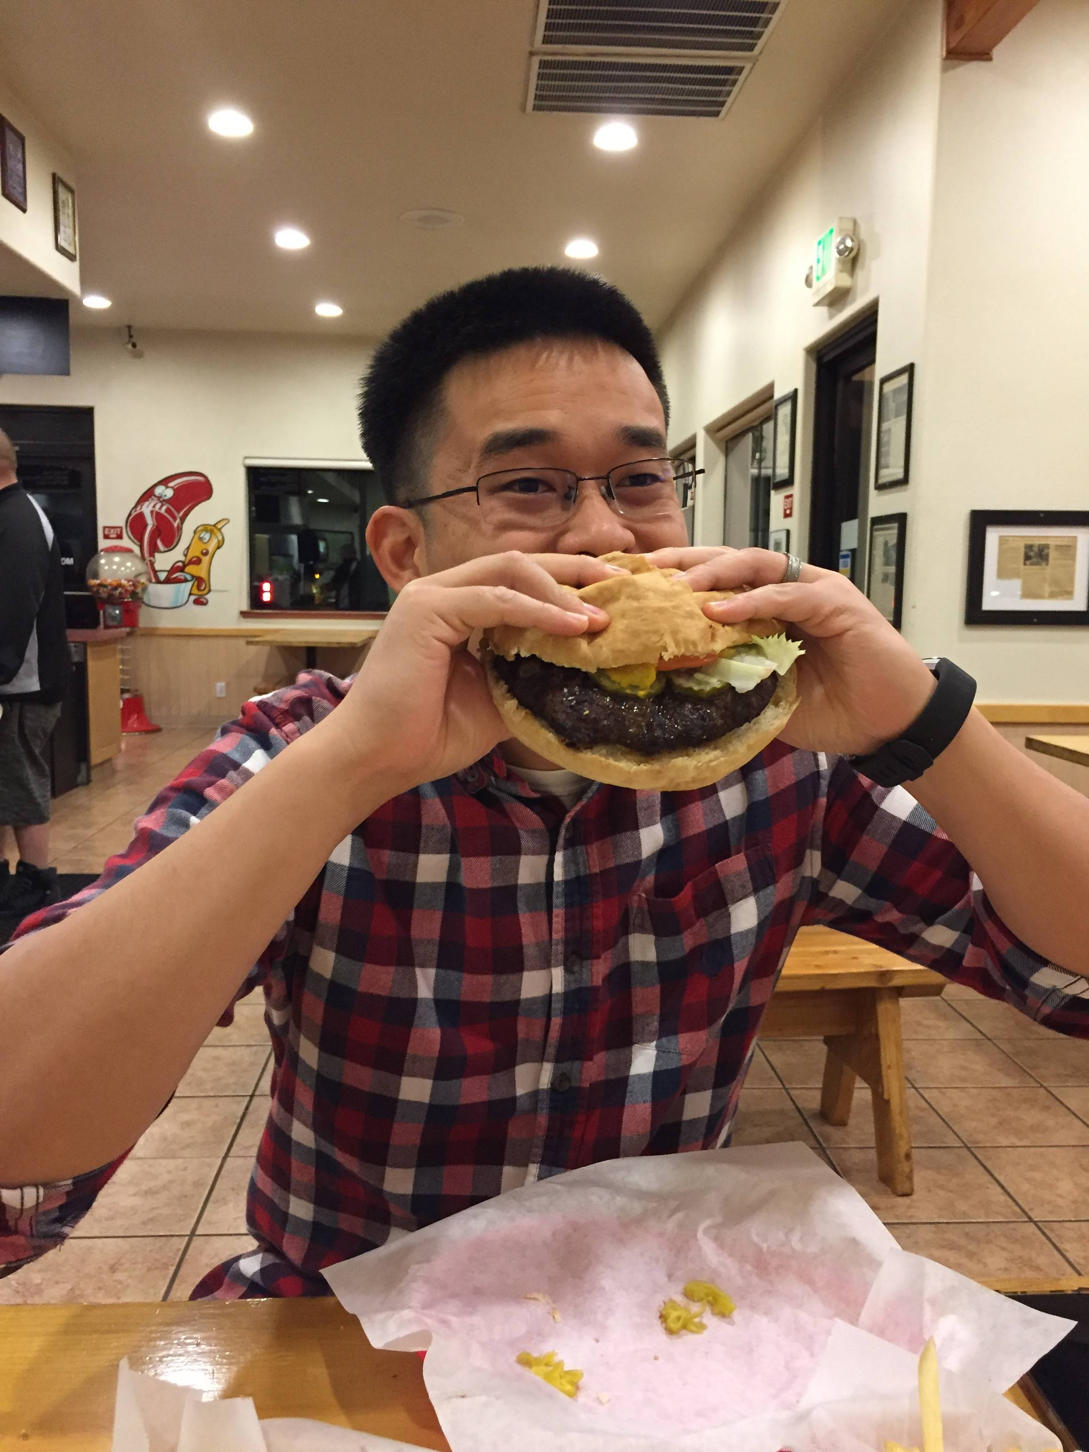
Stewart He
Science & Engineering: member of technical staff at LLNL
Joined LLNL in 2017 and worked on:
Pilot 1 – modeling drug tumor response
GA-drugs LDRD – predicting free energies from MD simulations
AHA – running safety and pharmacokinetic predictions on 1.6 billion drugs for Covid-19.
ATOM – Applying PQSAR to public datasets.
Education:
BS from UC Berkeley in EECS
PhD from UC Davis in Computer Science
Keywords:
Machine learning, drug development, hamburgers, Dungeons and Dragons, video games.
he6@llnl.gov
1lb burger from Big Chico Burger

Slide 8
Seminar #4 by Dr. Susan Mertins
Date - Thu July 7, 2022, 2:00 pm – 3:00 pm ET
Meeting Link - https://teams.microsoft.com/l/meetup-join/19%3ameeting_MjQ5YjgxNGEtYjEwNC00ZGQ4LThlZDYtYWM1ZTA4NmYzZjlm%40thread.v2/0?context=%7b%22Tid%22%3a%2214b77578-9773-42d5-8507-251ca2dc2b06%22%2c%22Oid%22%3a%222e31b4fb-2c54-4995-be48-173a24bc5b84%22%7d
TITLE - Modeling Dynamic Cellular Reaction Networks: Applications to drug discovery and development
PRESENTER – Dr. Susan D. Mertins, Ph.D. Senior Investigator, FNLCR
ABSTRACT - In this seminar, an introduction to modeling reaction networks computationally will be addressed. Current efforts capitalize on GUIs that allow biologists with little mathematical background to create depictions of important signal transduction pathways. Further, this type of modeling, accomplished with ordinary differential equations (ODEs), is particularly useful in drug discovery and development. Mechanistic modeling of drug mechanism of action could predict therapeutic output and the same models could allow identification of biomarkers. The MAPK pathway will be introduced, simulations presented, and future modeling efforts discussed.

Slide 9

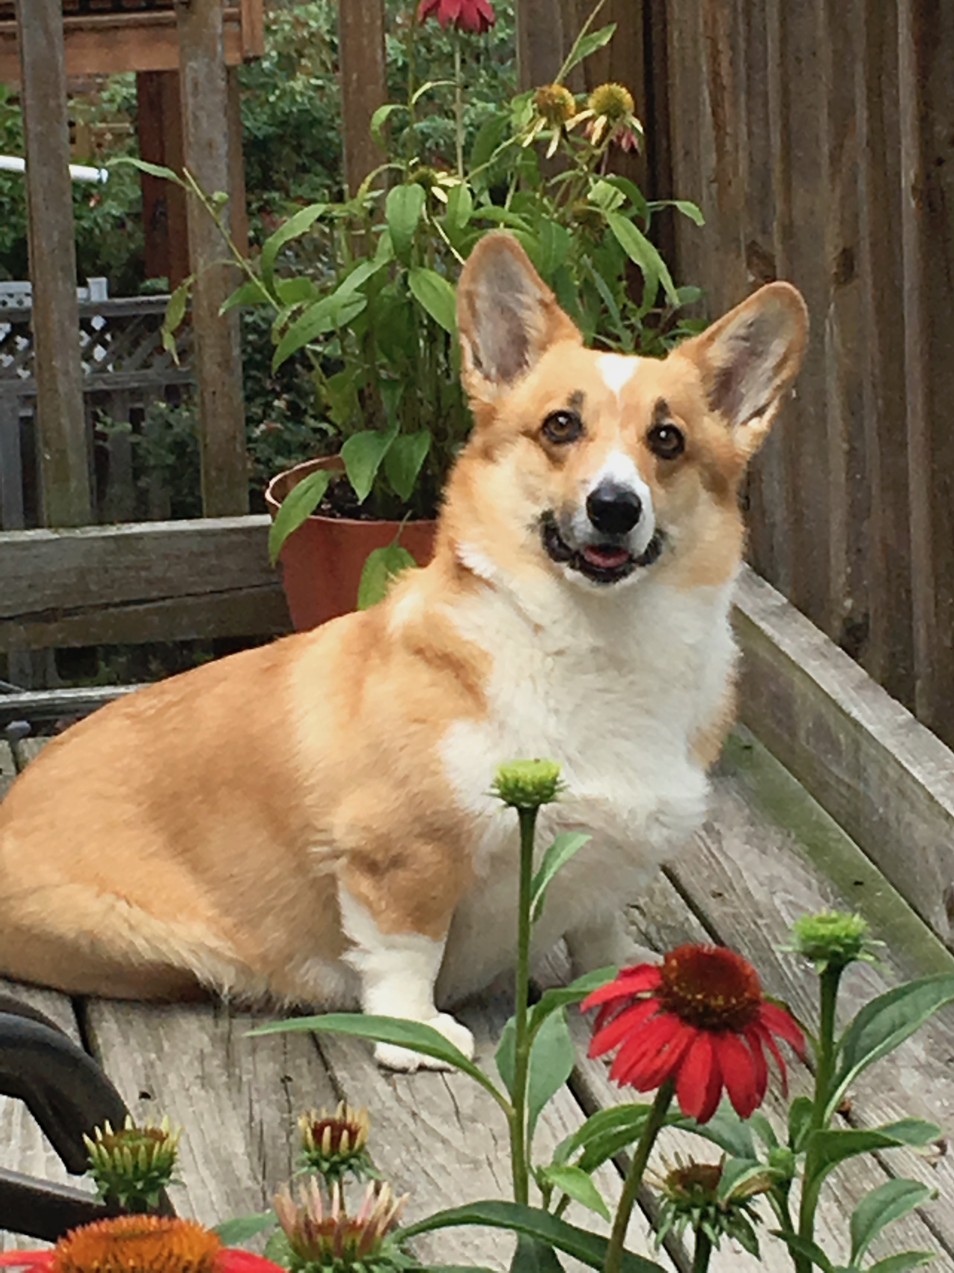
Susan Mertins
Senior Investigator, FNL and Founder and CEO BioSystems Strategies, LLC
My Experience
30+ years at the NIH
Drug Discovery and Development, both wet and dry lab
12 years at Mount St. Mary’s University, Emmitsburg, MD
BioSystems Strategies, LLC – Biotech Startup
Education
BS, MS, PhD, George Washington University
Outside Interests
Quilting, gardening, bird watching, reading
Dog training
My dog Bibbs won two blue ribbons in Conformation
susan.mertins2@nih.gov

